Slide 1
Review 1 - Accidents analysis
Submitted by :
Aakash Ratha
18BCE1237

Slide 2
Problem Statement
According to a survey, it has been found out that each year 1.35 million people are killed on roadways around the world.
Every day, almost 3,700 people are killed globally in road traffic crashes involving cars, buses, motorcycles, bicycles, trucks, or pedestrians.
Road traffic injuries are estimated to be the eighth leading cause of death globally for all age groups and the leading cause of death for children and young people 5–29 years of age. More people now die in road traffic crashes than from HIV/AIDS.
So, There is a need to reduce this number of accidents happening around the world.

Slide 3
DATA
This is a countrywide car accident Dataset, which covers 49 states of the USA. The accident data is collected from February 2016 to June 2020.Currently, there are about 3.5 million accident records in this dataset.
I have used the Dataset from kaggle. Link for this Dataset : https://www.kaggle.com/sobhanmoosavi/us-accidents
Applications :
This Dataset can be used for numerous applications such as real-time accident prediction, studying accident hotspot locations, casualty analysis and extracting cause and effect rules to predict accidents, or studying the impact of precipitation or other environmental stimuli on accident occurrence.

Slide 4
Objectives
Complete analysis of each accident.
Understanding the factors due to which accident takes place.
Data Visualization
Developing some kind of algorithm which helps the driver to identify accident zones in order to reduce the count of accidents taking place.
Predicting results with the help of existing R models.

Slide 5
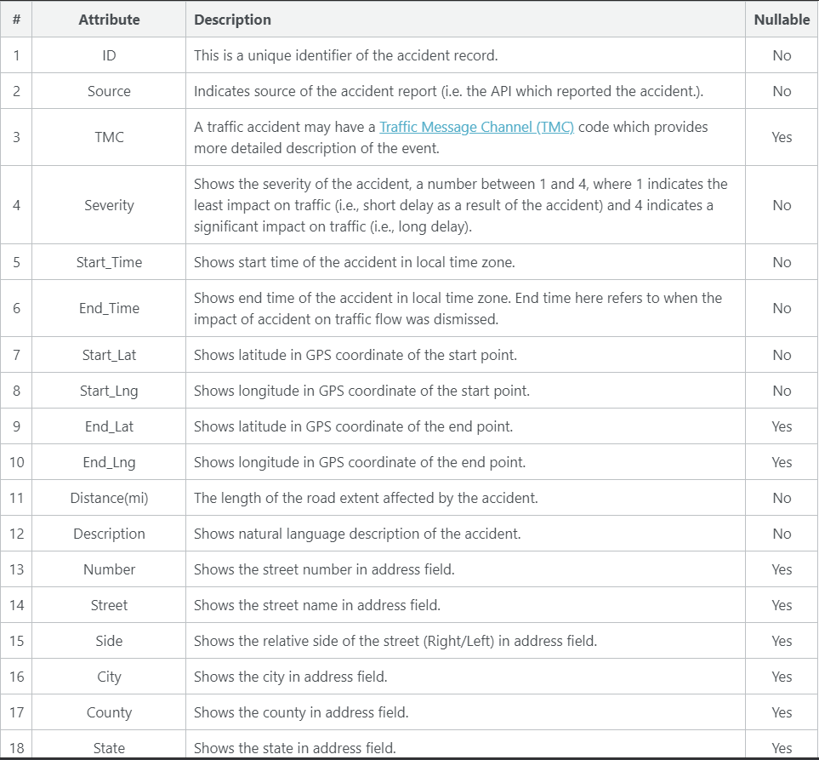
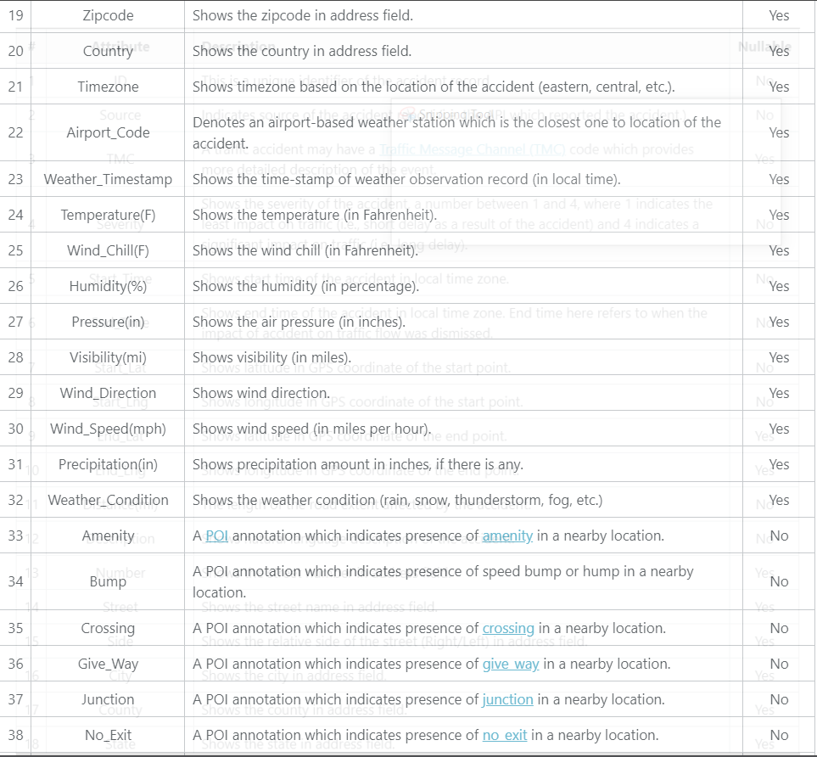
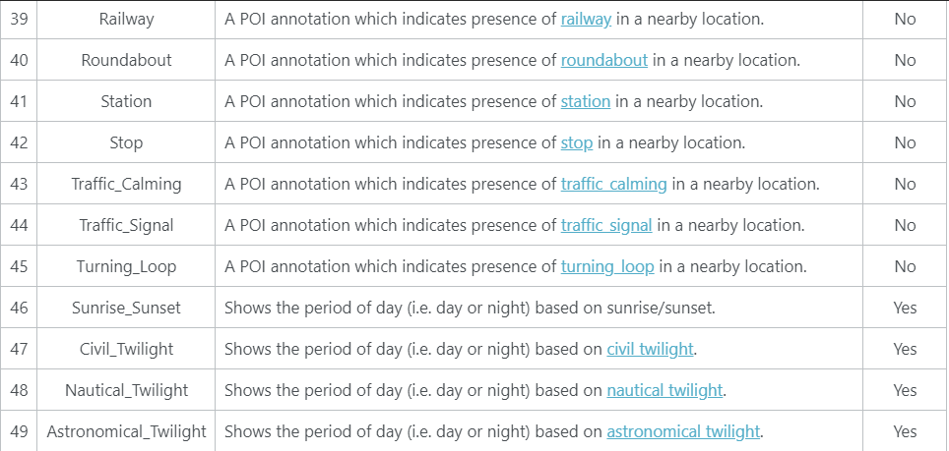
Format
The data is provided in terms of a CSV file.
Total number of Columns = 49

Slide 6
Previously work done
Every month this data is getting updated as the traffic condition and road conditions are also rapidly changing. Many people have done research on the old data, since this data is getting updated frequently on monthly basis, that's the reason why still analysis is going on.

Slide 7
THANK YOU

